Slide 1
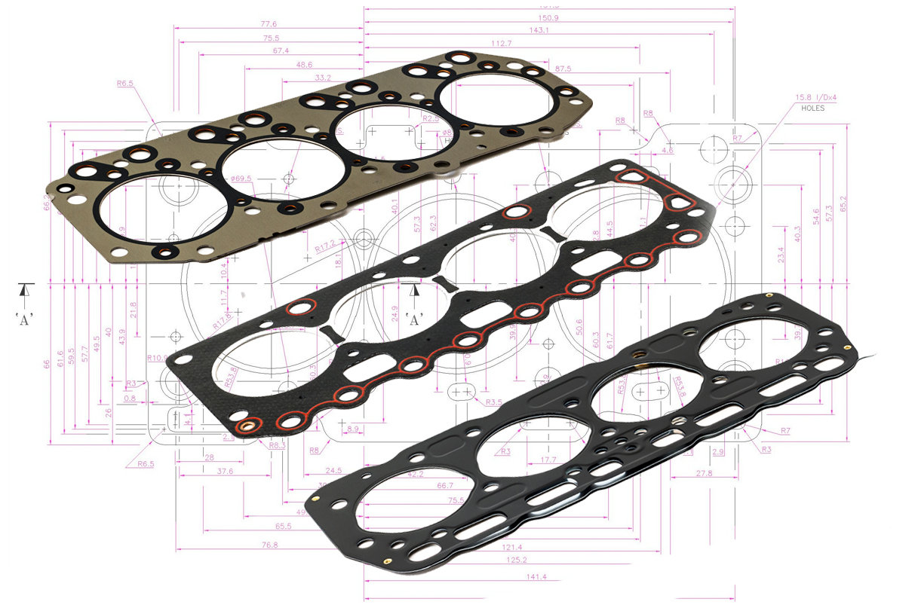

Slide 2
About FLEET Gaskets
Fleet Gaskets India Pvt. Ltd. was established in India in 1999 with a technical
know-how agreement with Fleet Gaskets Inc. of USA
Over last 23 years, Fleet has become one of the largest 2nd-Tier-suppliers
to leading OEMs in India and foreign markets
Fleet supplies products to OEMs in India and other major markets like US, Europe,
Australia and Far East
Fleet has a strong R&D Wing which is supplemented with a Quality department
and production infrastructure.
Fleet's gaskets are used in almost all car models of the world.

Slide 3
Team FLEET Gaskets
FLEET Team is led by Mr. Vijay Chopra – a thoroughbred Automobile Industry Expert having more than 4 decades of experience in importing, exporting, trading and manufacturing of automobile spare parts and components
Natasha Kochhar
Director
Mr. Ajay & Anil Kumar
MR & Quality
Mr. Pandey & Mr. Ashish
Production
Mr. Sood
Design & Development
Mr. Anowar
Customer Relation
Vijay Chopra
CMD ( Sales & Mktg)

Slide 4
Infrastructure
Fleet has two modern and state of art factories – with proper production facilities to meet the OEM quality and delivery standards.
The first facility is at the Okhla Industrial Area, of New Delhi – the capital of India. We also have our Export Office here.
The second facility is in IMT Faridabad which is going to be 100% export oriented unit, a industrial township in the Haryana State. This is exclusively a production centre.

Slide 5
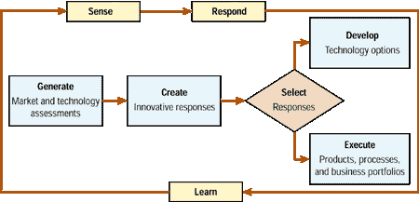
Research & Development
FLEET has a strong in-house R&D Team equipped with state of art design software and
hardware
Our R&D team regularly comes out new designs to meet challenging and time-bound
requirements of our customers

Slide 6




Diesel Particulate Filter Gaskets

Slide 7





Wire Mesh Gaskets

Slide 8
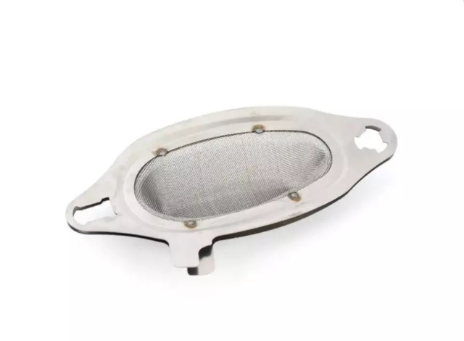
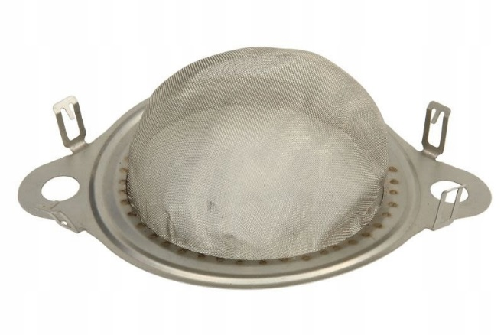


EGR Gasket

Slide 9




EGR Gasket

Slide 10




Exhaust Gaskets

Slide 11




Intake And Exhaust Manifold Gaskets

Slide 12
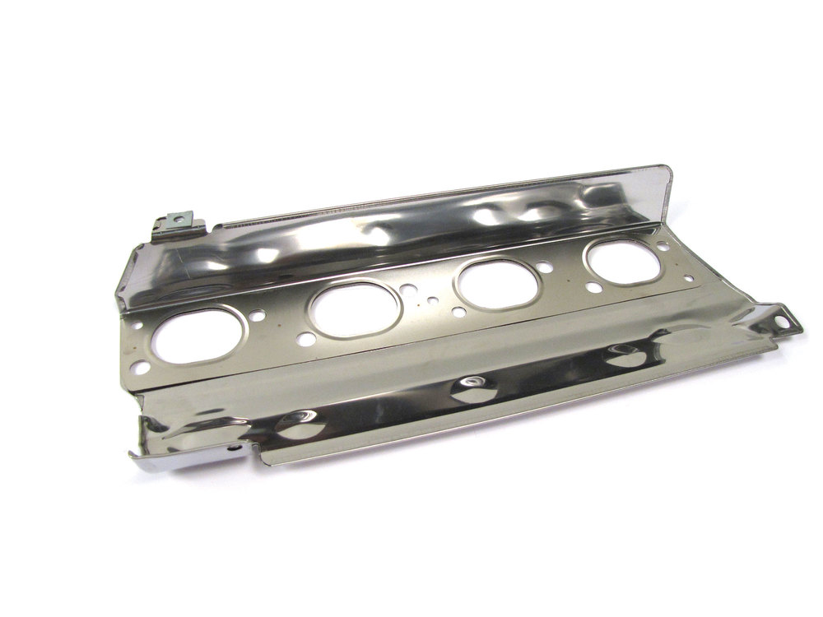
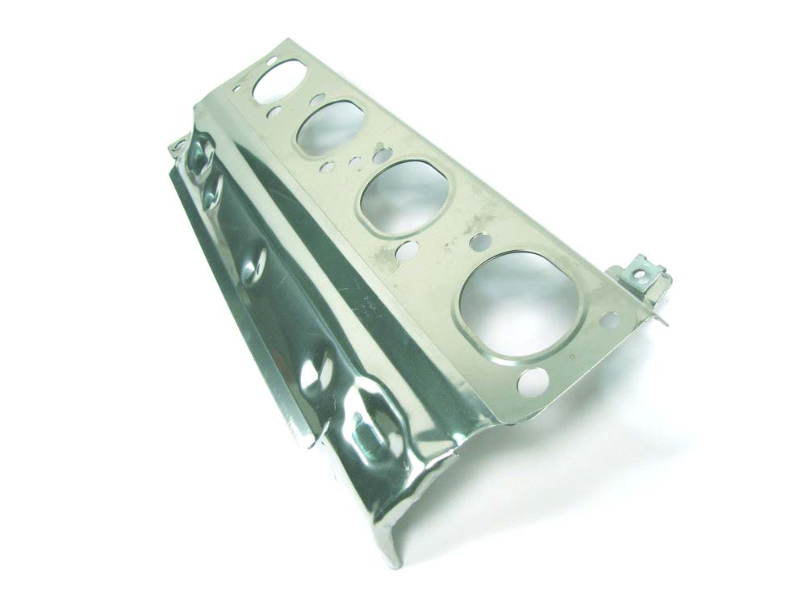
Heat Shield

Slide 13
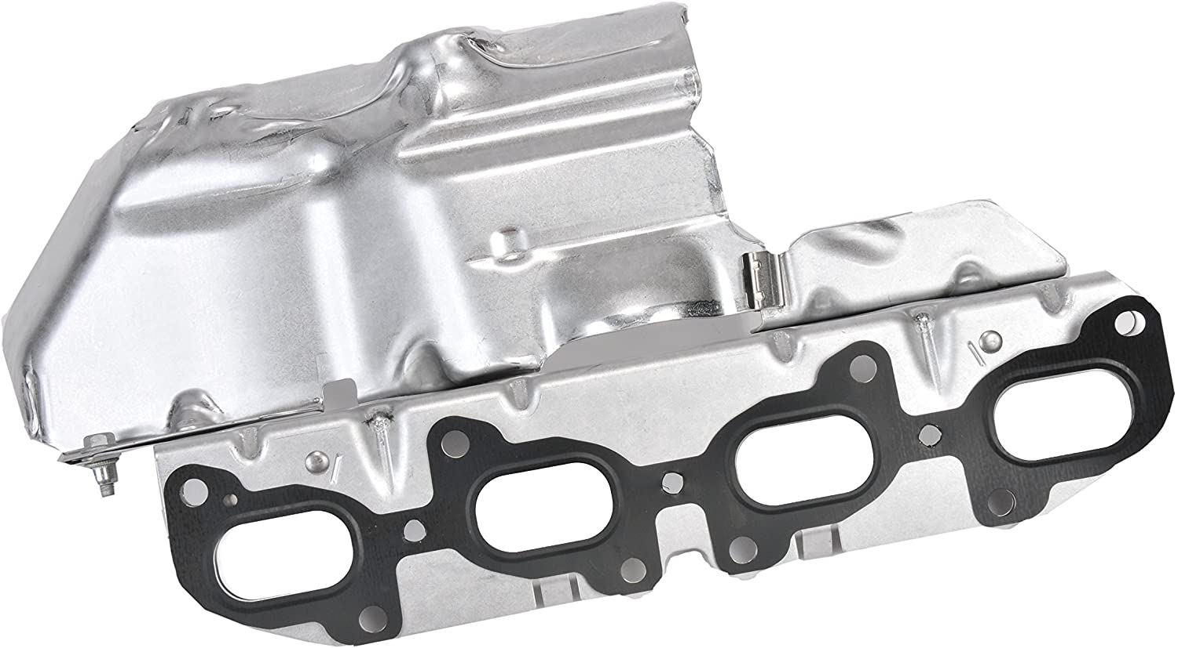
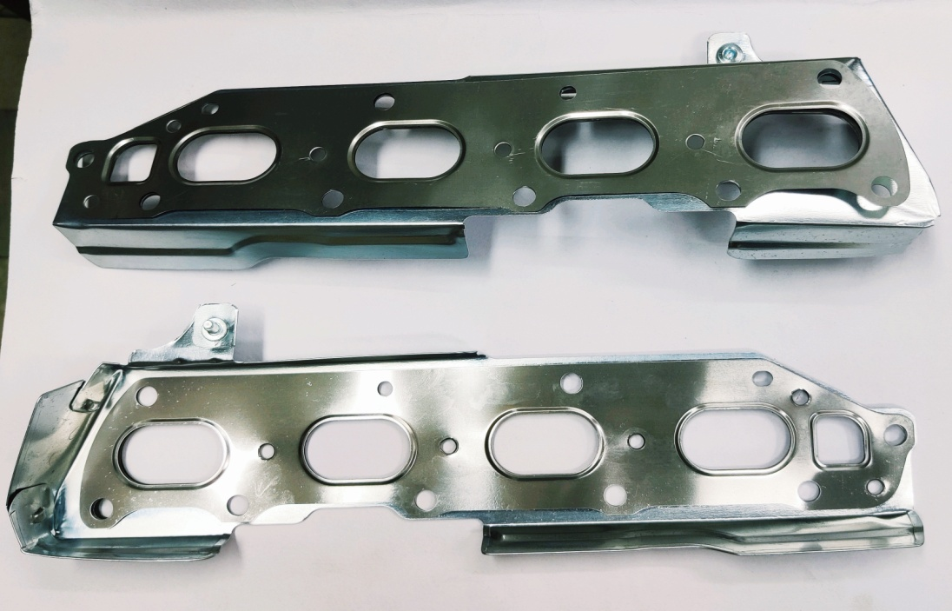
Heat Shield

Slide 14


Heat Shield

Slide 15
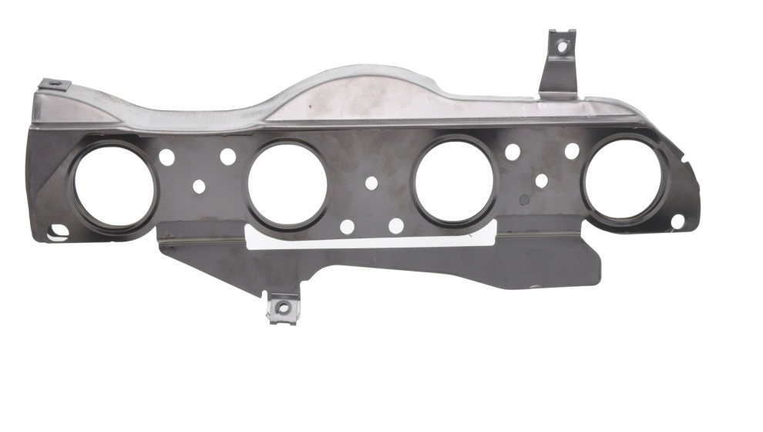
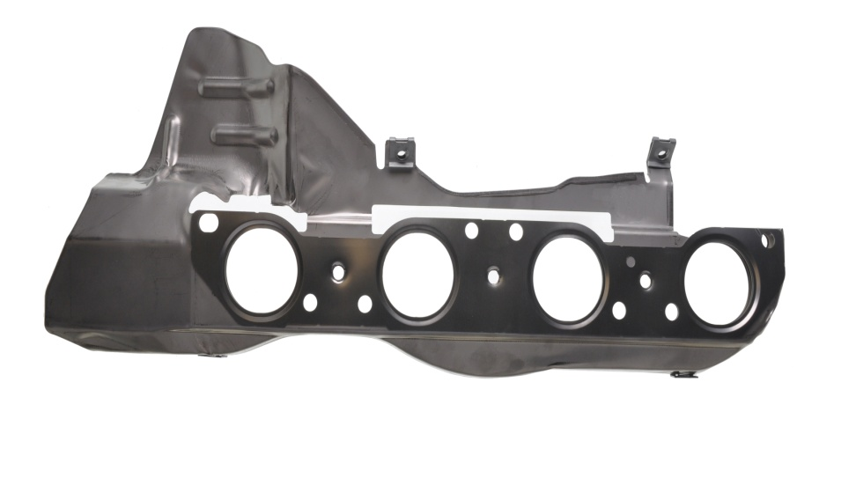
Heat Shield

Slide 16


Heat Shield

Slide 17




Heat Shields

Slide 18




Valve Rocker Cover & Oil Pan Gaskets

Slide 19




Cylinder Head Gaskets

Slide 20




Cylinder Head Gaskets

Slide 21
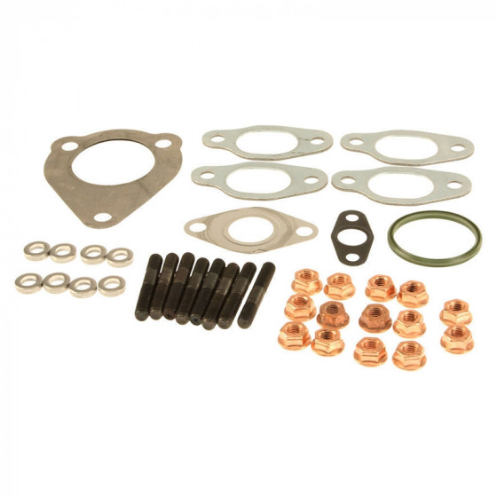

Turbo Charger Kit

Slide 22
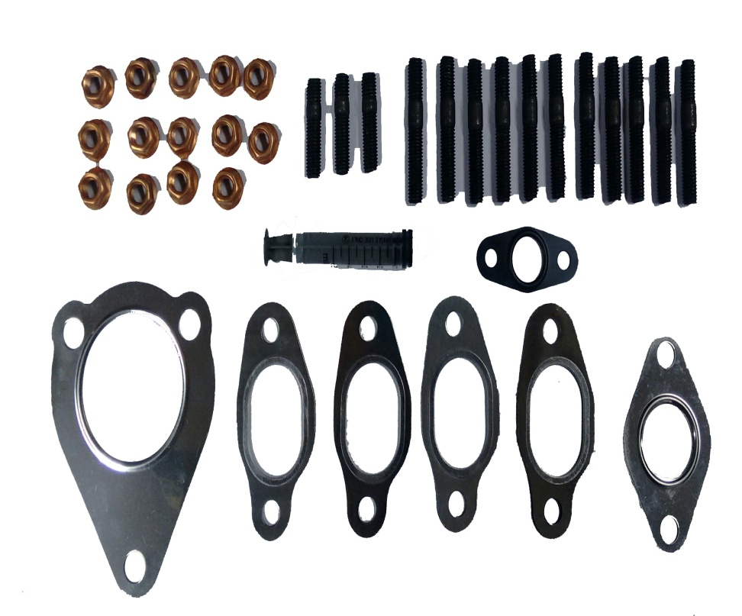
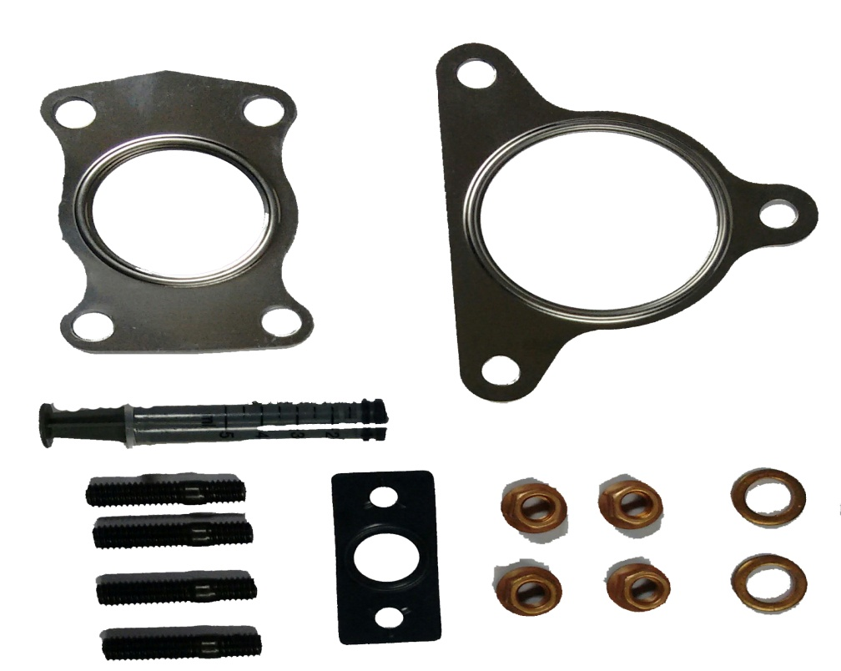
Turbo Charger Kit

Slide 23

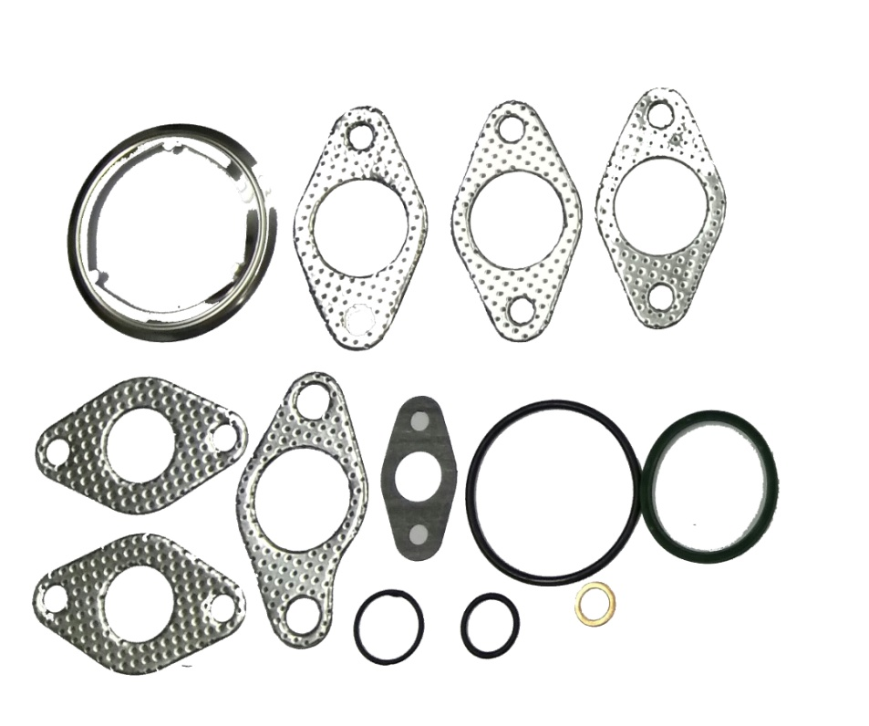
Turbo Charger Kit

Slide 24

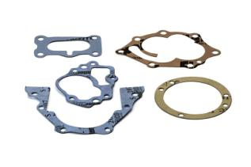


Soft Gaskets

Slide 25



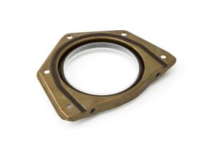
Oil Seals

Slide 26
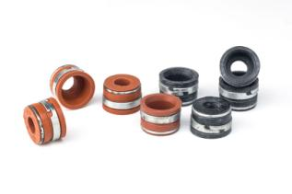
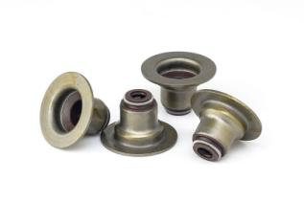

Valve Stem Seals

Slide 27


Sealants

Slide 28

Certifications – IATF 16949:2016

Slide 29
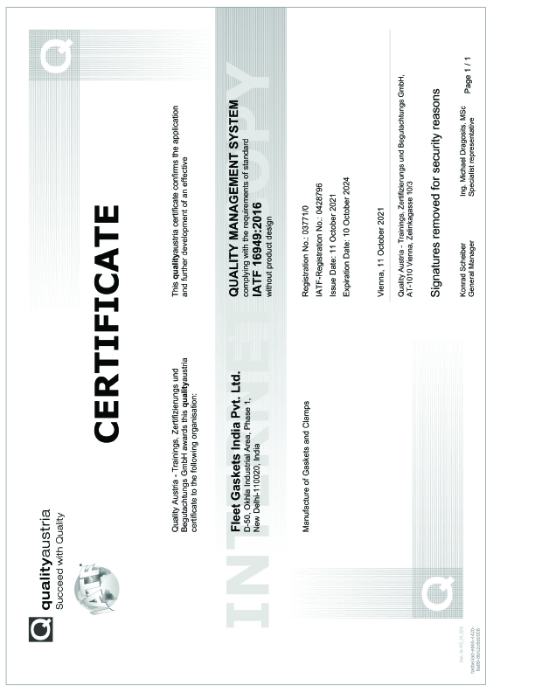
Certifications – IATF 16949:2016

Slide 30
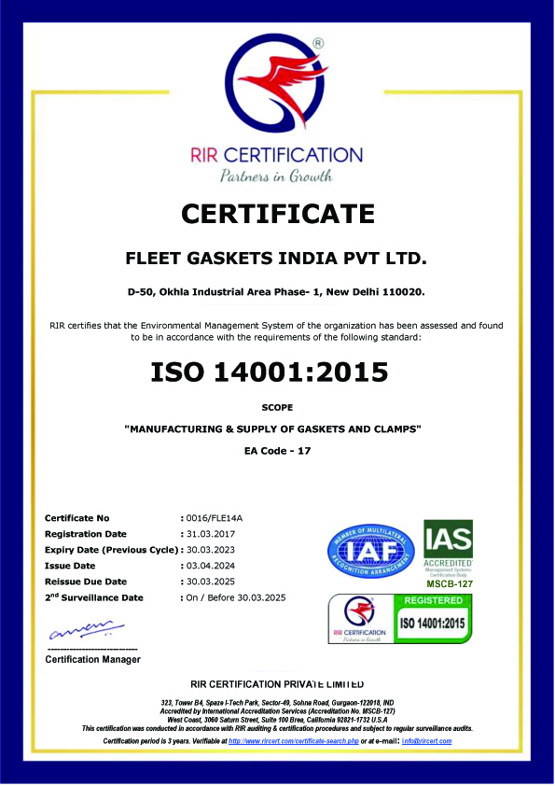
Certifications – ISO 14001:2015

Slide 31
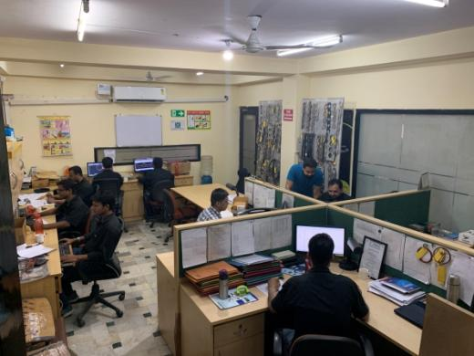
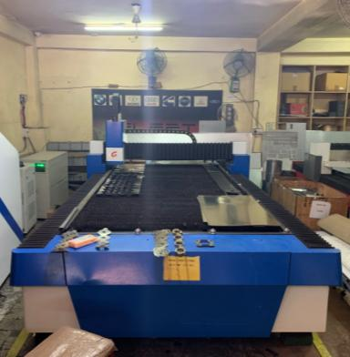
Plant Walkthrough

Slide 32
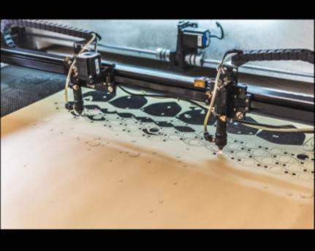
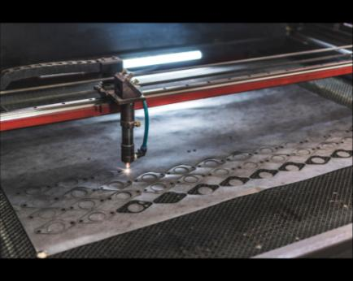
Plant Walkthrough

Slide 33
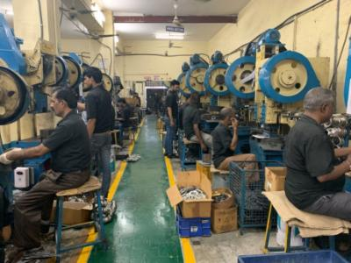
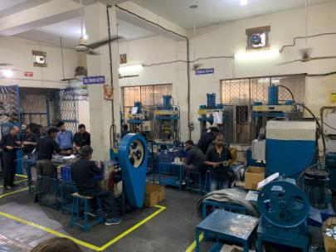
Plant Walkthrough

Slide 34
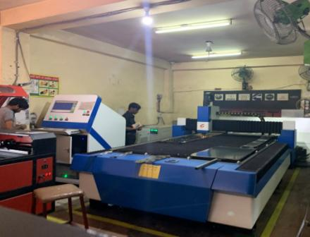
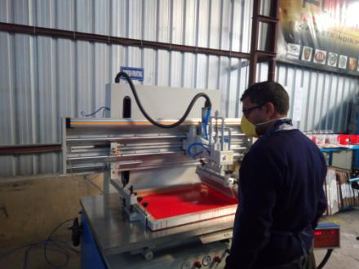
Plant Walkthrough

Slide 35
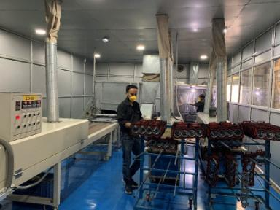
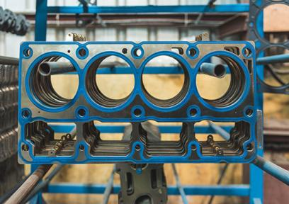
Plant Walkthrough

Slide 36
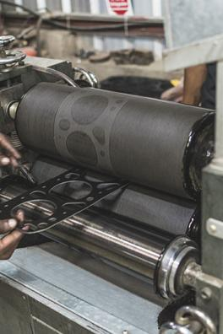
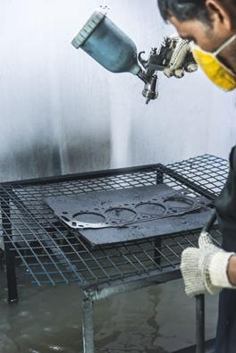
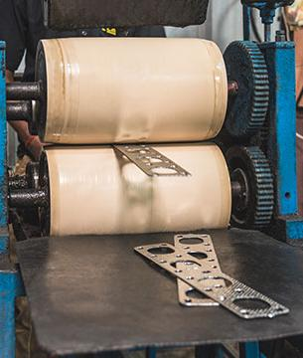
Plant Walkthrough

Slide 37
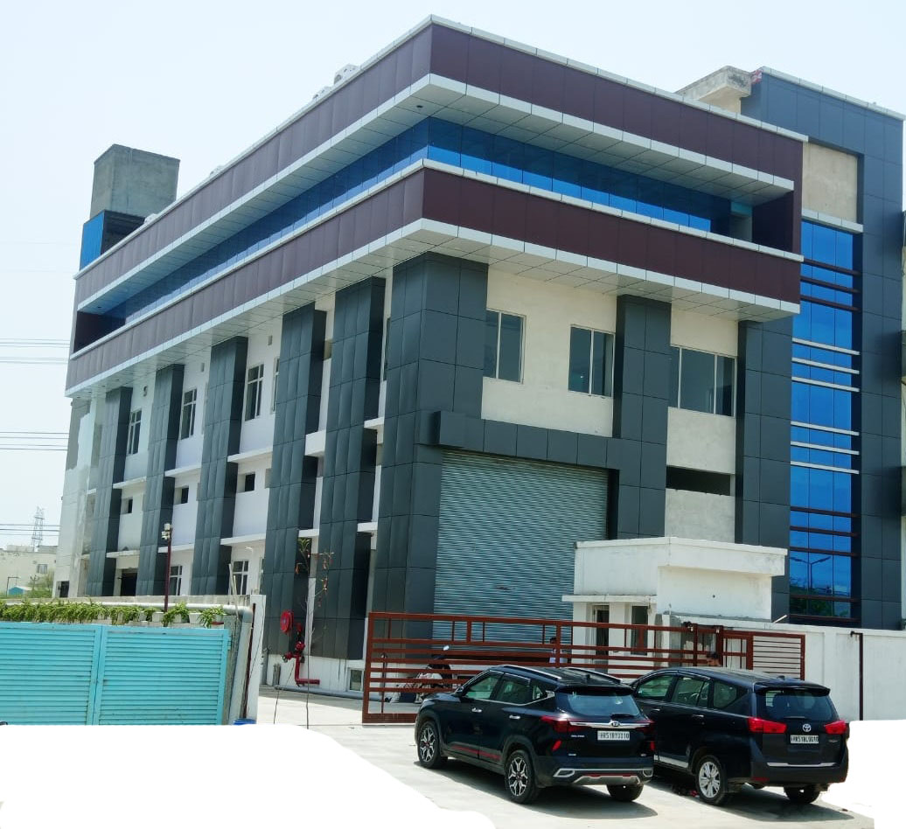
OUR NEW PLANT

Slide 38
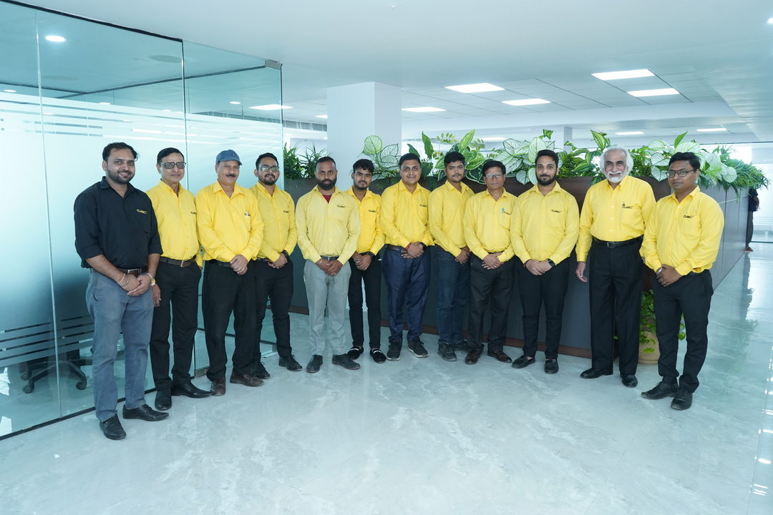

Plant Walkthrough-Office Area

Slide 39
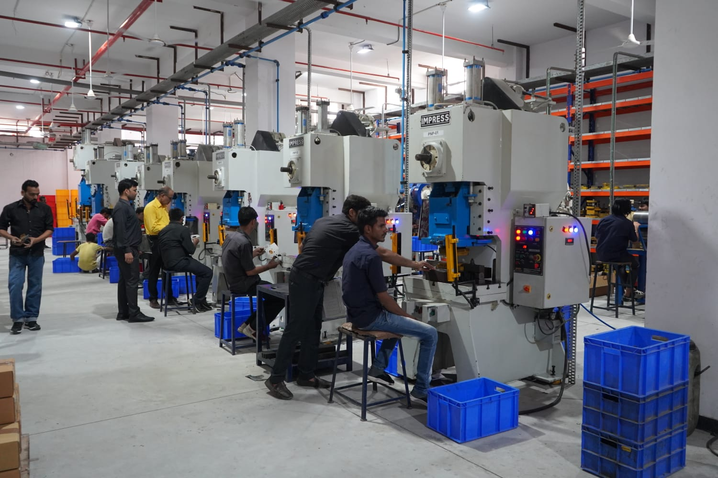
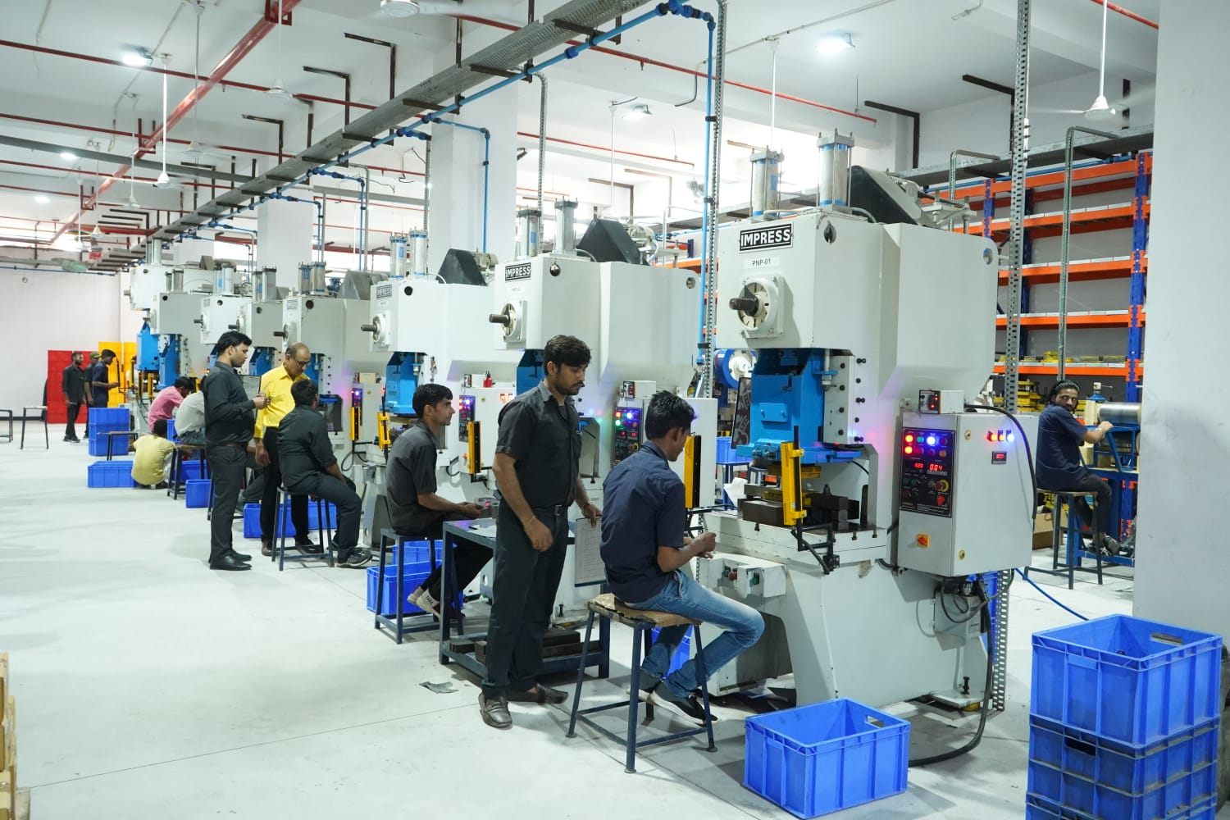
Plant Walkthrough-Production Area

Slide 40
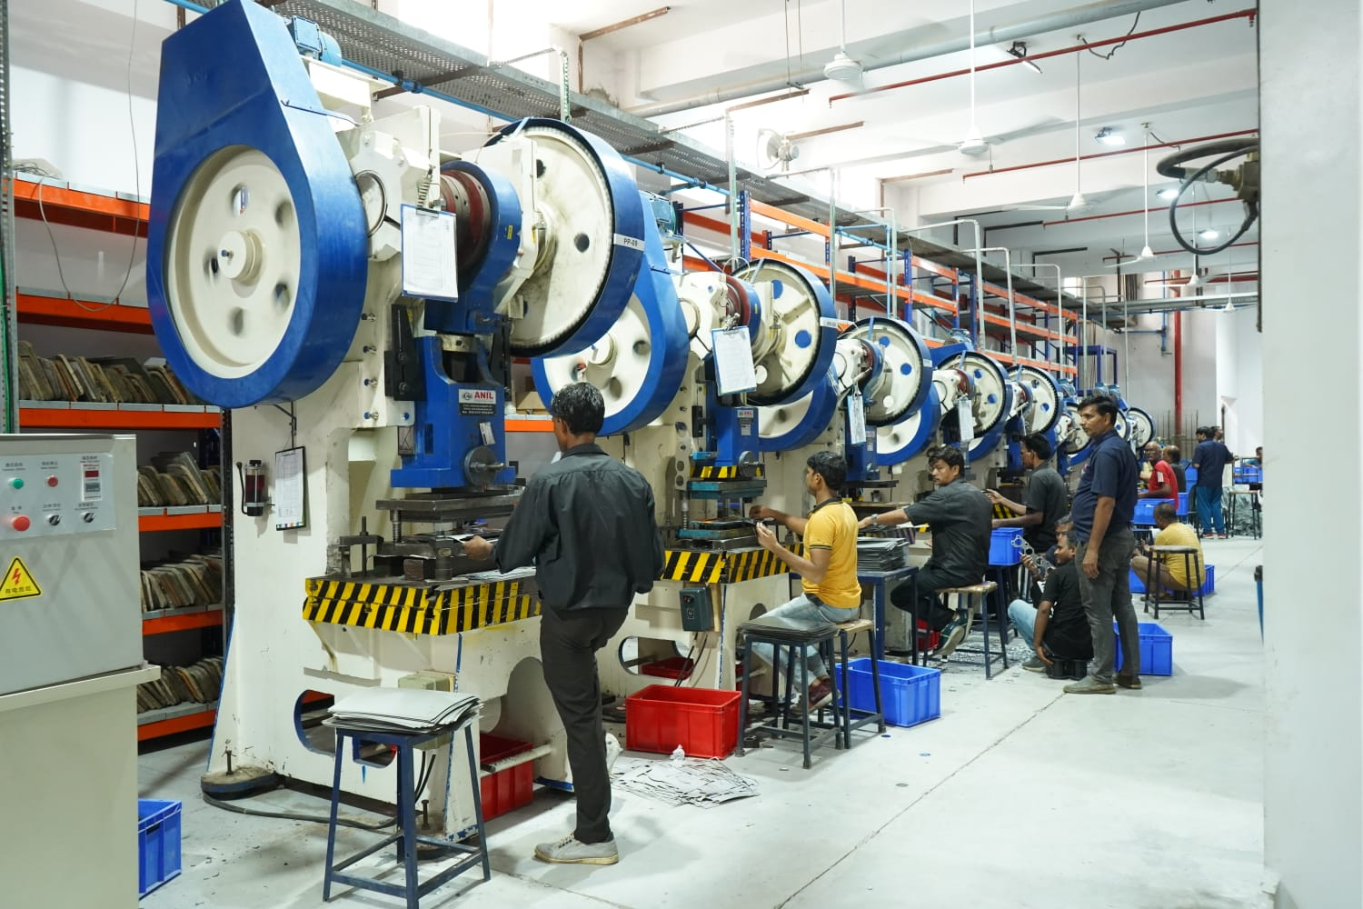
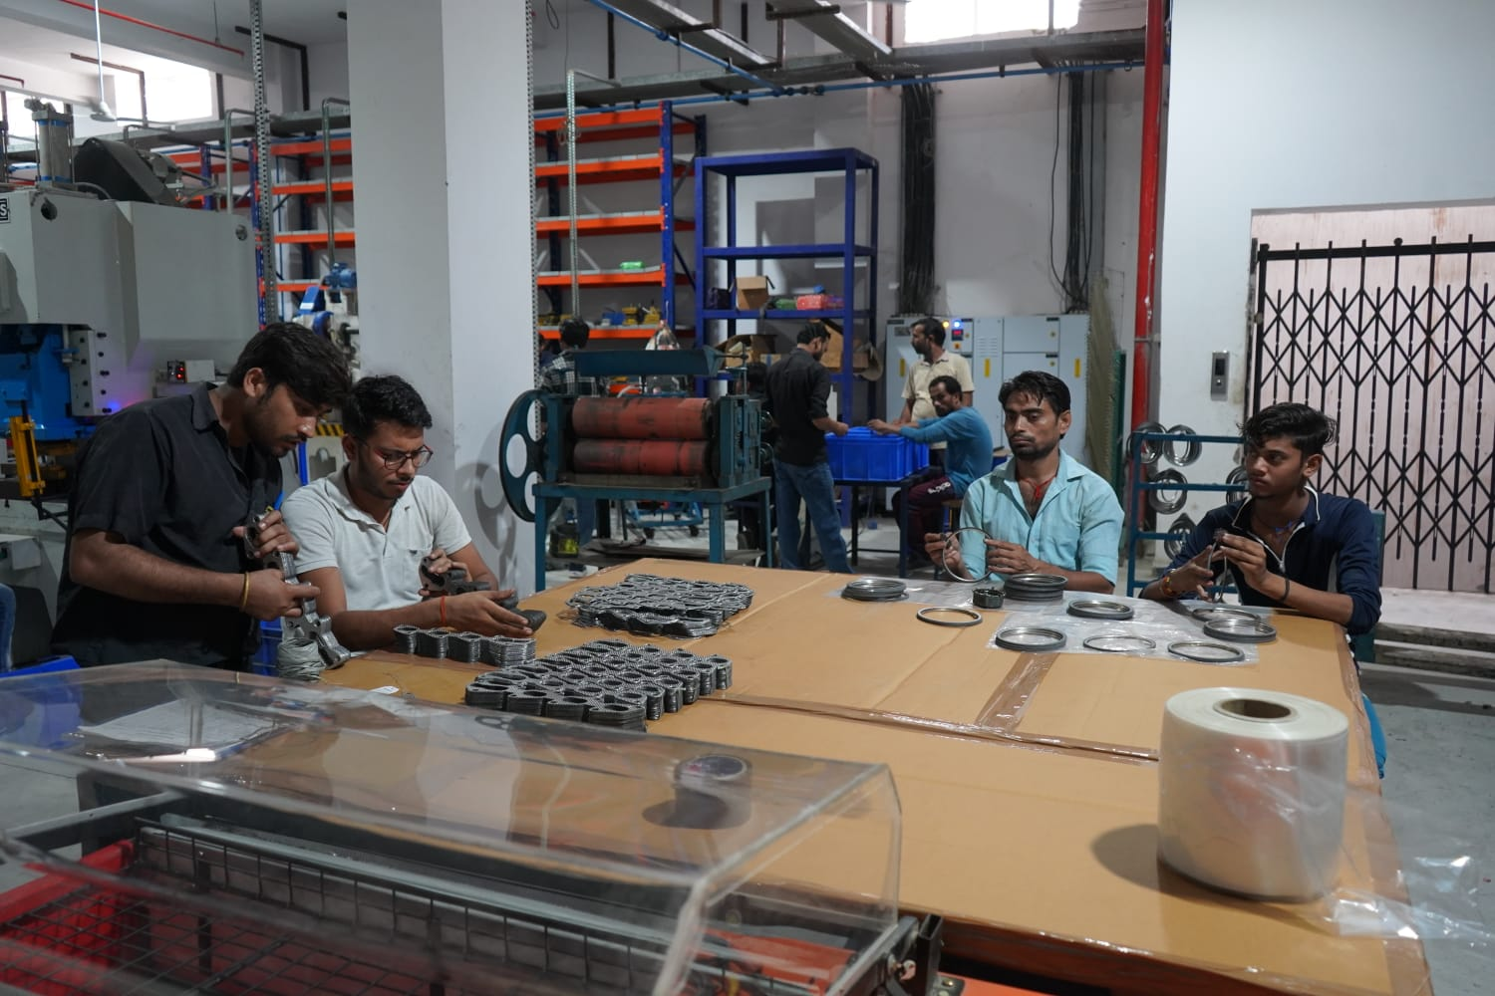
Plant Walkthrough-Production Area

Slide 41
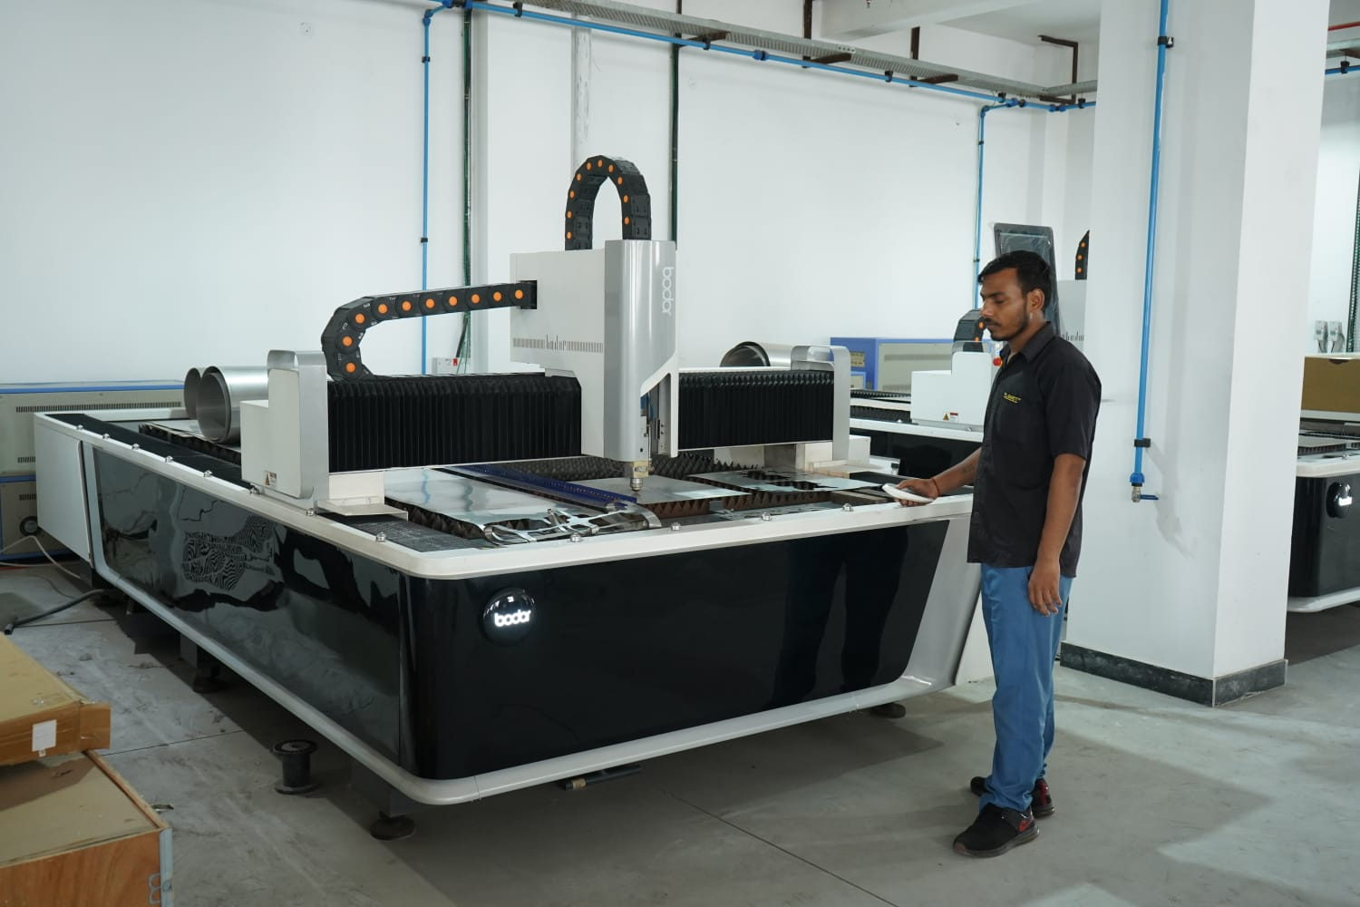
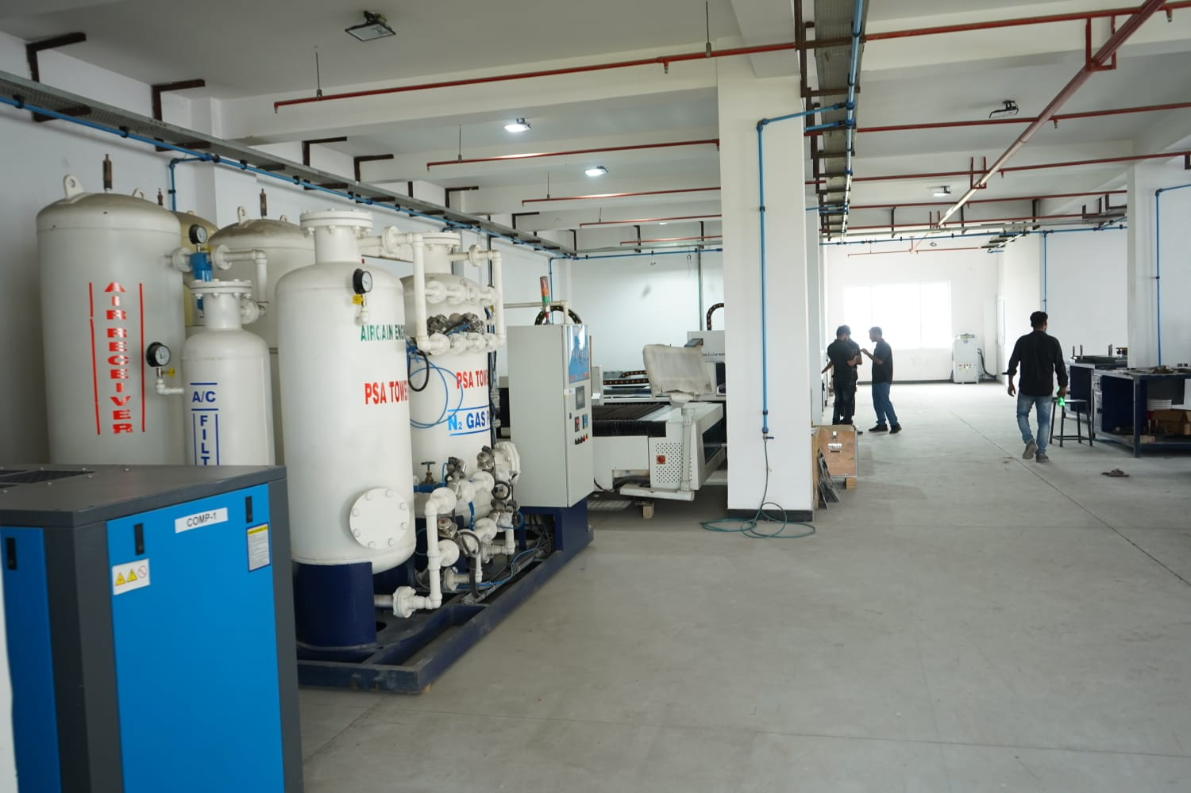
Plant Walkthrough-Laser Machine & Nitrogen Plant

Slide 42
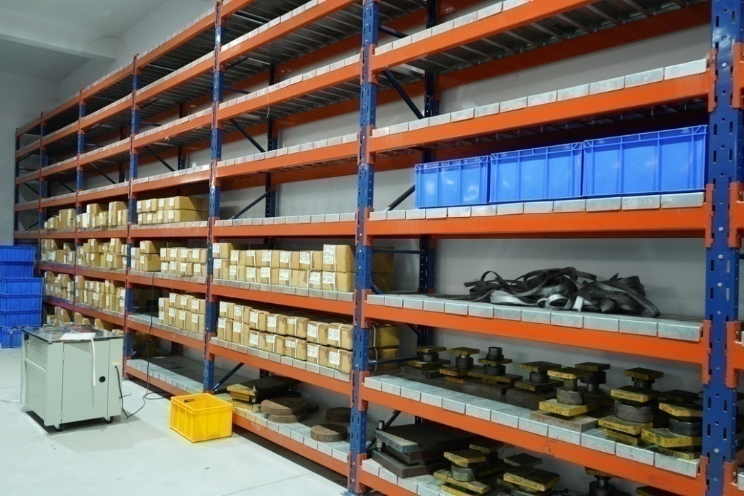
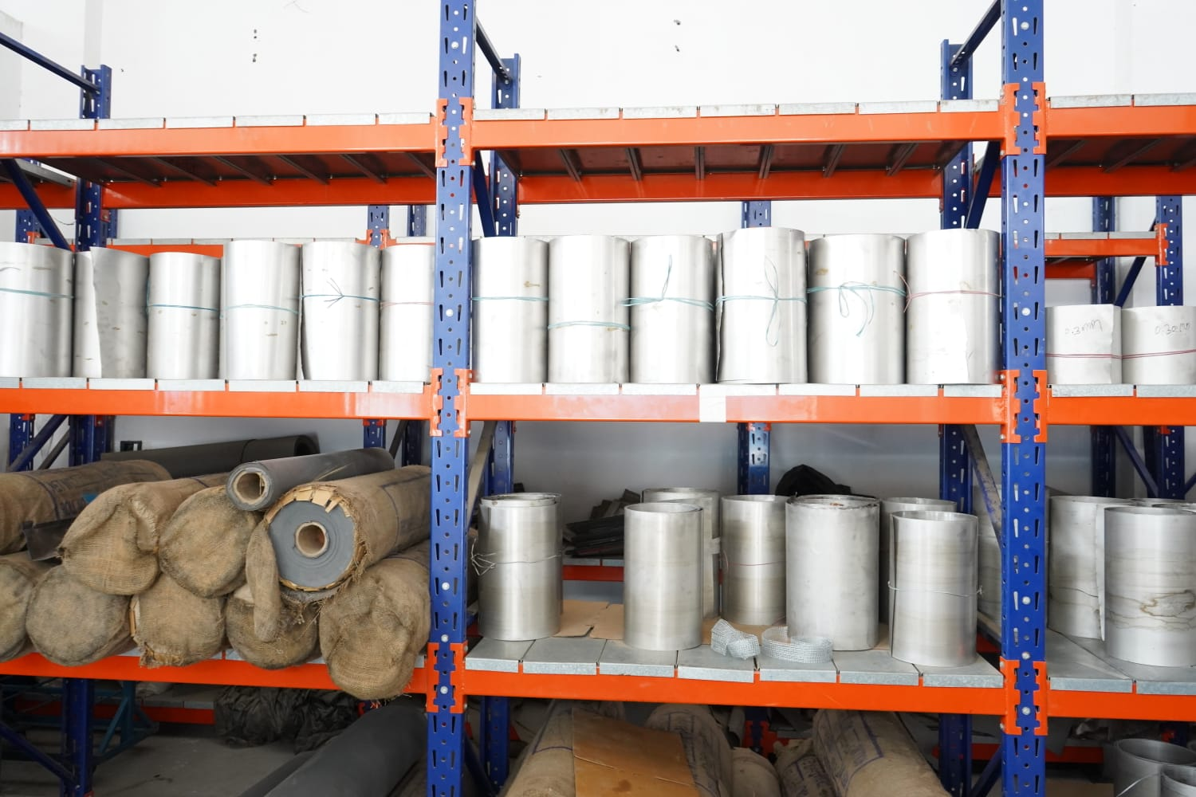
Plant Walkthrough-Store Area

Slide 43
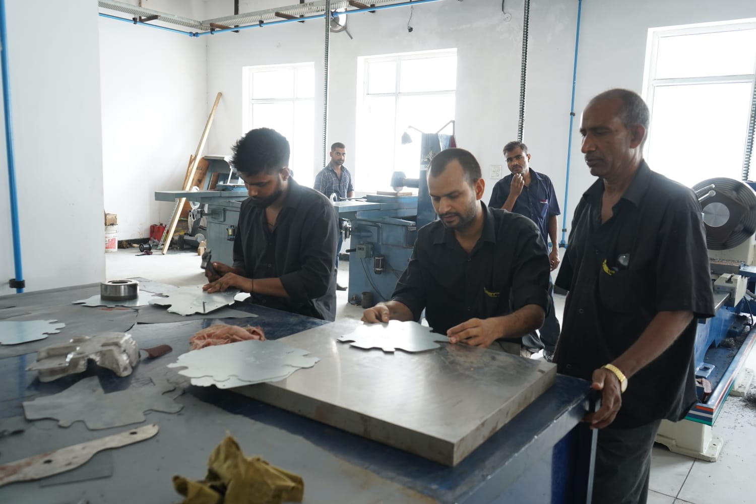
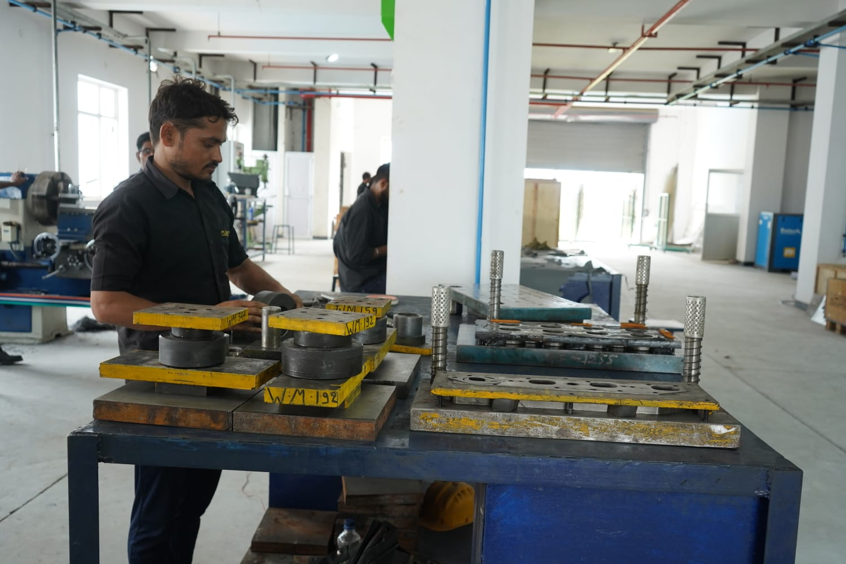
Plant Walkthrough-Tool Room

Slide 44

Product Catalogue
The complete range of FLEET Catalogue is available in the website
Click on the icon to download our Catalogue

Slide 45



FLEET GASKETS INDIA PVT. LTD
Works : D-50, Okhla Industrial Area, Phase I,
New Delhi-110020
Phone: +91-11-41519480, 81, 82
Email: info@fleetgaskets.net
Web: www.fleetgaskets.net
fleetgaskets
PRECISION AUTOMOTIVE COMPANY
Plot No. 139, Sector 68,
IMT Faridabad, Haryana-121004, India
Phone: +91-129-4006953, 4012214
Email : info@precisionautomotivecompany.com
Web.: www.precisionautomotivecompany.com

